Slide 1
Strategic Steering Teams
Phase II
February 2018 – May 2018
Notes:
1

Slide 2
Objectives
Focus and consolidate efforts of cross-functional groups to articulate, in a more direct and transparent way, our work towards strategic objectives as set forth in the Library/Press Strategic Actions for Temple University Libraries (July 2017).
Help to coordinate work of projects and working groups within “spheres” of strategic action and provide direction to those groups in articulating goals, objectives and assessment of success.
Provide more lateral, less hierarchical organizational structure for staff to share responsibility in work towards share goal.
Notes:
2

Slide 3
Related Strategic Contexts
Technology
Projects
Designing and building a dramatically new library environment to serve as a catalyst for the academic enterprise at Temple
Serving as a repository of record for archival, rare, and unique materials and providing broad access to those collections
Building a world class staff for leadership in the research library enterprise
Enriching the environment for learning and student success
Serving as a center for intellectual and cultural life
Developing programs, services, and resource to enhance intellectual property, scholarly infrastructure, new modes of research and clinical care services
Staff Learning & Development
Collaborations, Grants & External Projects
Outreach to Campus & Community

Slide 4
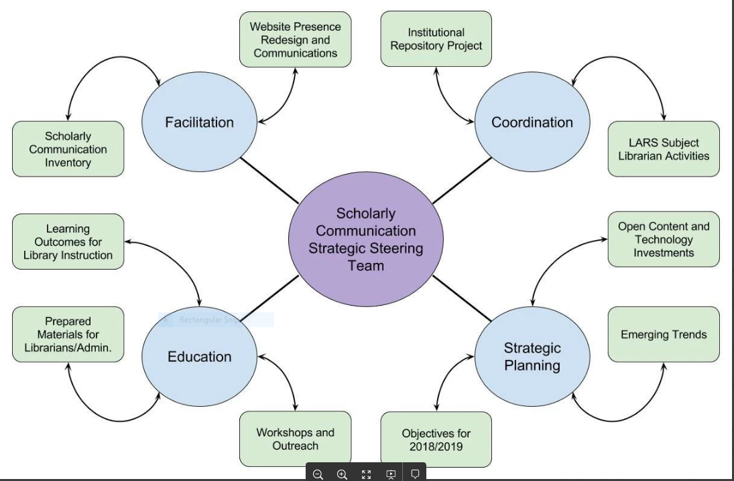
SCHOLARLY COMMUNICATION
STRATEGIC SPHERE: Version 2

Slide 5
RESEARCH DATA SERVICES STRATEGIC
ACTION SPHERE
Technology
Projects
Data Management Services
Strategic Steering Team
Staff Learning & Development
Institutional Repository
Data Discovery Group
Collaborations,
Grants, External Projects
Outreach to Campus & Community
NNLM Data Pilot Project
Campus Partnerships & Research Support
GIS Day 2017 Planning Committee
Civic Data Project
Data Education (outward facing) Group
Notes:
5

Slide 6
OUTREACH & COMMUNICATIONS SPHERE
Programming
Membership: Includes Representatives from SCRC, Blockson, Ambler, DSC, HSL
Outreach & Communications
Strategic Steering Team
Outreach, Academic Integration & Partnerships
Internal Communications
Notes:
6

Slide 7
Collections Strategy Steering Team
Collections Strategy
Team Lead, Brian Schoolar
Members:
Barbara Kuchan
Olivia Costello
Karen Kohn
Holly Tomren
Justin Hill,
Margery Sly
Brian Boling
To be determined
To be determined
Collections Strategy Steering Team
Physical Collections
Continues work on planning for move to new building. Led by Justin Hill

Slide 8
Current Teams and Membership
Established October 2017 | Established January 2018 | Future Team
Scholarly Communication Team Lead, Annie Johnson Members: Stephanie Roth, Rachel Appel, | Outreach & Communication Members: John Pyle, | Learning and Student Success
Research Data Services Team Lead, Gretchen Sneff Members: Matt Shoemaker, Jenny Pierce, | Collections Strategy Team Lead, Brian Schoolar Member: Karen Kohn, Holly Tomren, Justin Hill, Margery Sly, Brian Boling
Notes:
8

Slide 9
Benefits
Within a Sphere of Strategic Action, structure provides for more participation (and leadership) at multiple levels (steering team, project group members)
Steering Teams have core responsibility for oversight and coordination of activities and projects in their area of strategic action.
Steering Teams provide a mechanism for pulling different team efforts together while retaining autonomy of current team work
Steering Teams help to insure that goals, objectives and assessment is taking place across the organization.
Notes:
9

Slide 10
Transparency
Confluence serves as space for high level communication to staff about Strategic Steering Teams, goals and activities
Charge
Objectives/Goals
Minutes of meetings
Finalized documents
Google Documents (Team Drives) used for working documents
Annual Report

Slide 11
Team Development Process
The Strategic Steering Teams write their own charge, identifying needs in their “sphere” of strategic action. This process might include:
Data collection and analysis
Internal/external scan
Draft charge
Determine priorities for action and goals related to those.
Think about impact

Slide 12
Activity Time Frame Feb 2018 to Apr 2018
Activity | Responsibility | Date
Outreach & Communication begins meeting | N Turner | February 2018
Collections Strategy Group proposed and membership finalized | N Turner
Scholarly Communication finalizes charge and goals | A Johnson
Research Data Services finalizes charge and goals | G Sneff
Confluence Presence established | All Groups
Budget Process Proposal to Leadership Council | N Turner | March 2018
Assessment Plan for Teams Implemented | N Turner with All | March 2018
Communications to ADC, Staff | N Turner, Team Leads | March 2018
Notes:
12

Slide 13
Ongoing Evaluation
As beta projects, work of groups will be assessed in terms of:
Team functioning
assigning leads,
establishing membership,
defining roles
Cooperative leadership in setting charge and priorities and
Providing team members opportunities for learning
Coordinating and moving forward on strategic actions

Slide 14
Outstanding Challenges and Questions
Insuring that process allows for all interested staff to be engaged in strategic action work
Coordination of goal-setting and projects across organization
Mechanism for robust communication between SST team leaders and the administrative unit heads
Resource allocation (technology, budget, technical expertise)
Decision making and authority – where does it reside?
Notes:
14

Slide 15
Operating principles
Self-directed
Charged to think holistically about the Libraries and its future
Works as a group, not as individuals
Organizationally, flat
In continuous beta

