Slide 1
Re-framing Cross-Functional Teams to Align with Strategic Actions
Beta Process: November 2017 – January 2018
Notes:
1

Slide 2
Objectives
Focus and consolidate efforts of cross-functional groups to articulate, in a more direct and transparent way, our work towards strategic objectives as set forth in the Library/Press Strategic Actions for Temple University Libraries (July 2017).
Help to coordinate work of projects and working groups within “spheres” of strategic action and provide direction to those groups in articulating goals, objectives and assessment of success.
Provide more lateral, less hierarchical organizational structure for staff to share responsibility in work towards share goal.
Notes:
2

Slide 3
Acknowledge:
Much of the work we are already doing at TULUP is:
Cross-functional
Strategic
Has wide participation of staff
Is effective team work
Notes:
3

Slide 4
And yet,
there is room for “tightening up” the current approach in order to:
Insure that teams have clear charges, goals, objectives and work plans
Coordinate strategic project work between administrative units and cross functional groups
Provide structure for more consistent and transparent approach to communicating strategic work
Strengthen culture of assessment and accountability across the organization

Slide 5
Recommendation: Strategic Steering Teams
Strategic Steering Teams are cross-functional
Strategic Steering Team writes its own charge. May conduct an informal environmental scan (internal, external); What’s going on now? What’s working?
Strategic Steering Teams serve to coordinate work of projects in their spheres, and provide direction to working groups and projects in articulating goals, objectives and assessment of success.
Strategic Steering Teams have 5-6 members, each committing 10-20% of effort on related work (this time may include leadership on an associated team or project)
Strategic Steering Team leaders serve on ADC+ to participate in strategic planning for organization
Notes:
The beta steering teams evolve from current working groups (Open Temple and Data Services Implementation Team) – both of these groups have informal charges. The steering teams evolve from these, so their charge, their work will continue, with relationship to strategic actions, perhaps, more clearly articulated.
5

Slide 6
Initial Teams and Structure:
Two beta teams:
Scholarly Communication*
Data Management Services*
Planned or potential teams developed in next 3-4 months
Outreach & Communication Collections Strategy* (est. Jan 2018)
Collections Strategy* (est. Jan 2018)
Learning and Student Success*
*identified in organizational chart
Notes:
6

Slide 7
Related Strategic Contexts
Technology
Projects
Designing and building a dramatically new library environment to serve as a catalyst for the academic enterprise at Temple
Serving as a repository of record for archival, rare, and unique materials and providing broad access to those collections
Building a world class staff for leadership in the research library enterprise
Enriching the environment for learning and student success
Serving as a center for intellectual and cultural life
Developing programs, services, and resource to enhance intellectual property, scholarly infrastructure, new modes of research and clinical care services
Staff Learning & Development
Collaborations, Grants & External Projects
Outreach to Campus & Community

Slide 8
SCHOLARLY COMMUNICATION
STRATEGIC SPHERE
Digital Scholarship & Publishing
Staff Learning & Development
Technology
Projects
Institutional Repository
Scholarly Communication
Strategic Steering Team
Collaborations, Grants, External Projects
Campus Partnerships & Research Support
NEH Humanities Open Book
RIM (Research Information Management) Library Team
Outreach to Campus & Community
OA Week at HSL planning group
Notes:
8

Slide 9
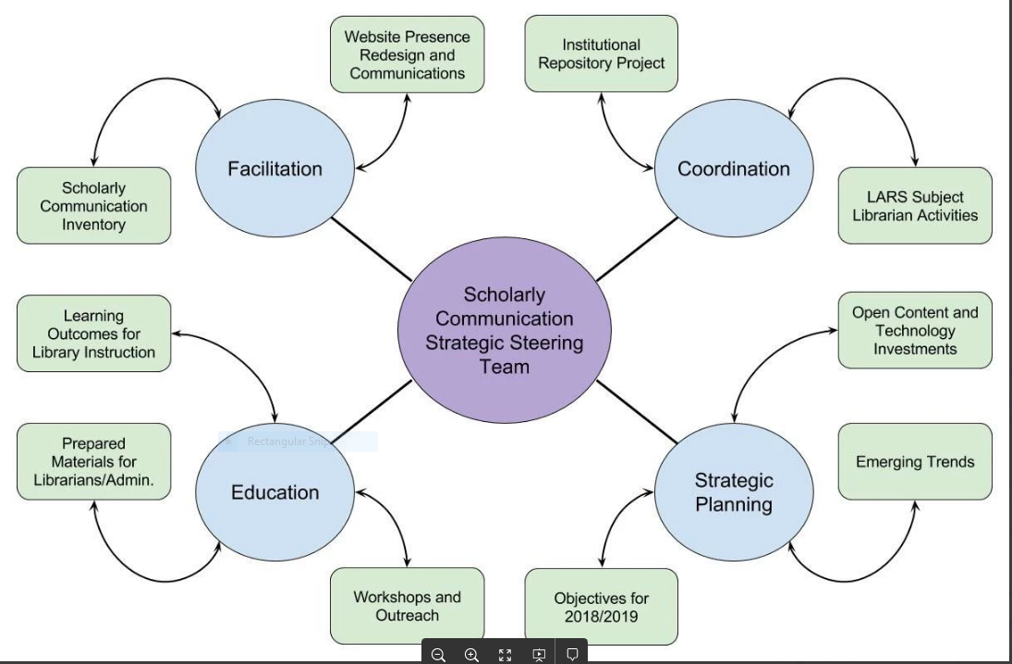
SCHOLARLY COMMUNICATION
STRATEGIC SPHERE: Version 2

Slide 10
RESEARCH DATA SERVICES STRATEGIC
ACTION SPHERE
Technology
Projects
Data Management Services
Strategic Steering Team
Staff Learning & Development
Institutional Repository
Data Discovery Group
Collaborations,
Grants, External Projects
Outreach to Campus & Community
NNLM Data Pilot Project
Campus Partnerships & Research Support
GIS Day 2017 Planning Committee
Civic Data Project
Data Education (outward facing) Group
Notes:
10

Slide 11
OUTREACH & COMMUNICATIONS SPHERE
Compared to other SST structures:
Similarities:
Strategic Steering Team comes to consensus on priorities and activities in the sphere
Satellite areas include broader membership, but include selected members of SST
Sub-teams set their own priorities and agenda
SST members contribute 10-20% of effort to work in sphere.
Differences:
Strategic Steering Team members do work within the sub-teams
Sub-teams are led by Outreach/Communications Administrator
Participation level can vary from 10-20% of effort. Flexibility due to different levels of staff and periodicity of activity
Programming
Membership: Includes Representatives from SCRC, Blockson, Ambler, DSC, HSL
Outreach & Communications
Strategic Steering Team
Outreach, Academic Integration & Partnerships
Internal Communications
Notes:
11

Slide 12
Collections Strategy Steering Team
The CSST prioritizes and takes steps towards developing a holistic and future-oriented strategy for collections of all types at Temple. In addition to Physical Collections group, satellite groups might focus on consortial relationships, electronic resources, open access, special collections, or other issues emerging from internal/external environmental scan.
Collections Strategy Steering Team
Physical Collections
Continues work on planning for move to new building. Led by Justin Hill

Slide 13
Potential Benefits
Within a Sphere of Strategic Action, structure provides for more participation (and leadership) at multiple levels (steering team, project group members)
Steering Teams have core responsibility for oversight and coordination of activities and projects in their area of strategic action.
Steering Teams provide a mechanism for pulling different team efforts together while retaining autonomy of current team work
Steering Teams help to insure that goals, objectives and assessment is taking place across the organization.
Notes:
13

Slide 14
Transparency
Confluence serves as space for high level communication to staff about Strategic Steering Teams, goals and activities
Charge
Objectives/Goals
Minutes of meetings
Finalized documents
Google Documents (Team Drives) used for working documents
Annual Report

Slide 15
Process: Team Membership Recruitment
Assign team leaders to strategic steering teams
Team Membership: Steering Team Lead, Assc. Dir. ORSA conduct initial recruitment based on current team participation, expertise and needs for team balance
Leaders of project groups may also serve on Steering Team
Membership of steering team is 5-6, including team leader.
Steering Team is 2-year term
Final decision on Steering Team is Assc. Dir. ORSA, Team Lead, Library Leadership Council
Notes:
15

Slide 16
Commitment from Administrative Units
Commit to at least one staff member, or unit head, to participate as member of one Strategic Steering Team. (10-20% effort)
ADC provides one forum for administrative unit heads and team leads to work collaboratively, insuring that strategic work and projects are coordinated
For instance, perhaps a semi-annual event (retreat, interactive presentations) for work on this

Slide 17
Ongoing Evaluation
As beta projects, work of groups will be assessed in terms of:
Team functioning
assigning leads,
establishing membership,
defining roles
Cooperative leadership in setting charge and priorities and
Providing team members opportunities for learning
Coordinating and moving forward on strategic actions

Slide 18
Activity Time Frame Oct 2017 to Jan 2018
Activity | Responsibility | Date
Update Library Leaderships Council | N Turner | By October 24, 2017
Update ADC+ | N Turner | By October 25, 2017
Finalize membership for Scholarly Communication | N Turner with Team Leader | October 30 – Nov 3 2017
Finalize membership for Data Services | N Turner with Team Leader | October 30 – Nov 3 2017
Communication to Staff | J Lucia w N Turner | October 30 – Nov 3 2017
Scholarly Communication begins meeting | Team Leader | Early November 2017
Data Services begins meeting | Team Leader | Early November 2017
Refine and Recruit for Outreach & Communication | N Turner | January 2018
Refine and Recruit for Collections Strategy | N Turner | January 2018
Notes:
18

Slide 19
Outstanding Challenges and Questions
Insuring that process allows for all interested staff to be engaged in strategic action work
Coordination of goal-setting and projects across organization
Mechanism for robust communication between SST team leaders and the administrative unit heads
Resource allocation (technology, budget, technical expertise)
Decision making and authority – where does it reside?
Notes:
19

Slide 20
Next Steps for Teams
The Strategic Steering Teams write their own charge, identifying needs in their “sphere” of strategic action. This process might include:
Data collection and analysis
Internal/external scan
Draft charge
Determine priorities for action and goals related to those.
Think about impact

Slide 21
What makes the Strategic Steering Teams so special?
Self-directed
Charged to think holistically about the Libraries and its future
Works as a group, not as individuals
Organizationally, flat
In continuous beta
Good luck!

